Slide 1
The MicroSupply
To measure and deliver

Slide 2
Table of contents
My creation
Information
How it works
Discussion

Slide 3
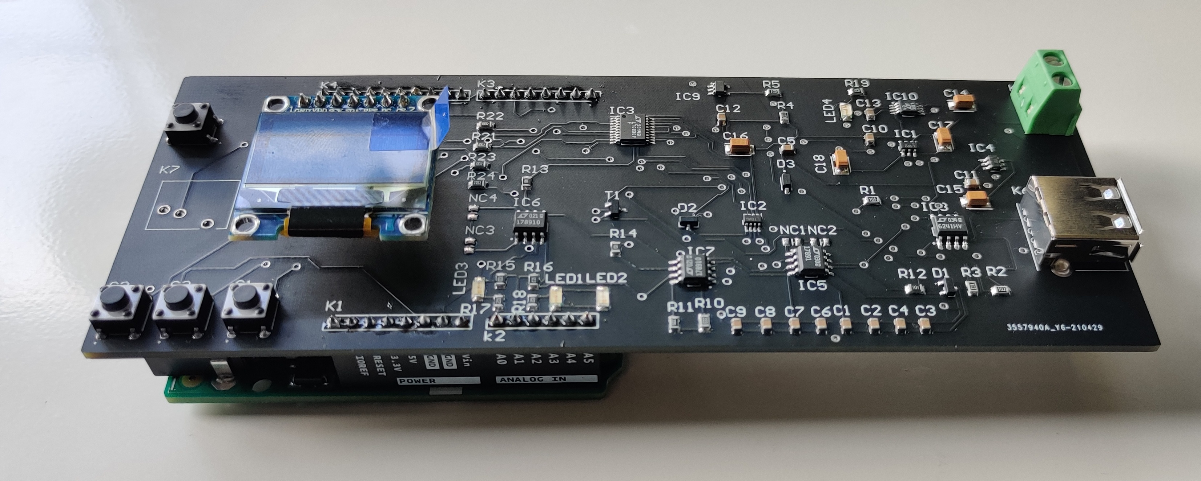

my creation
Measure small currents
Supply an adjustable voltage
Program

Slide 4
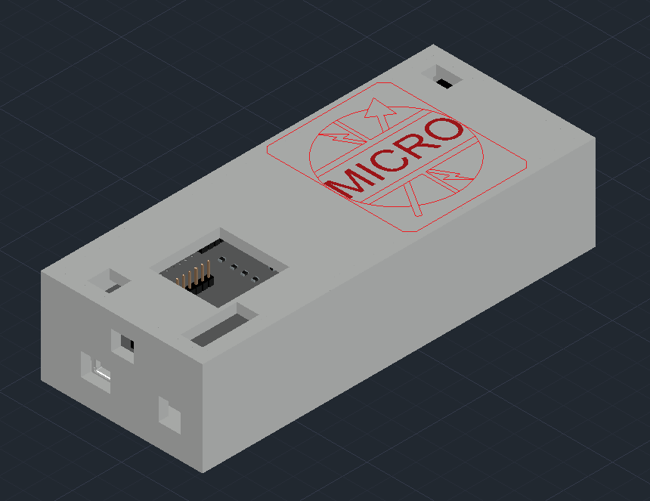
My creation
Autocad
Plexi
logo engraved

Slide 5
information
Future
Cost
interesting

Slide 6

How it works
Microprocessor
Visualisation OLED
Communication
Arduino software
Button control

Slide 7
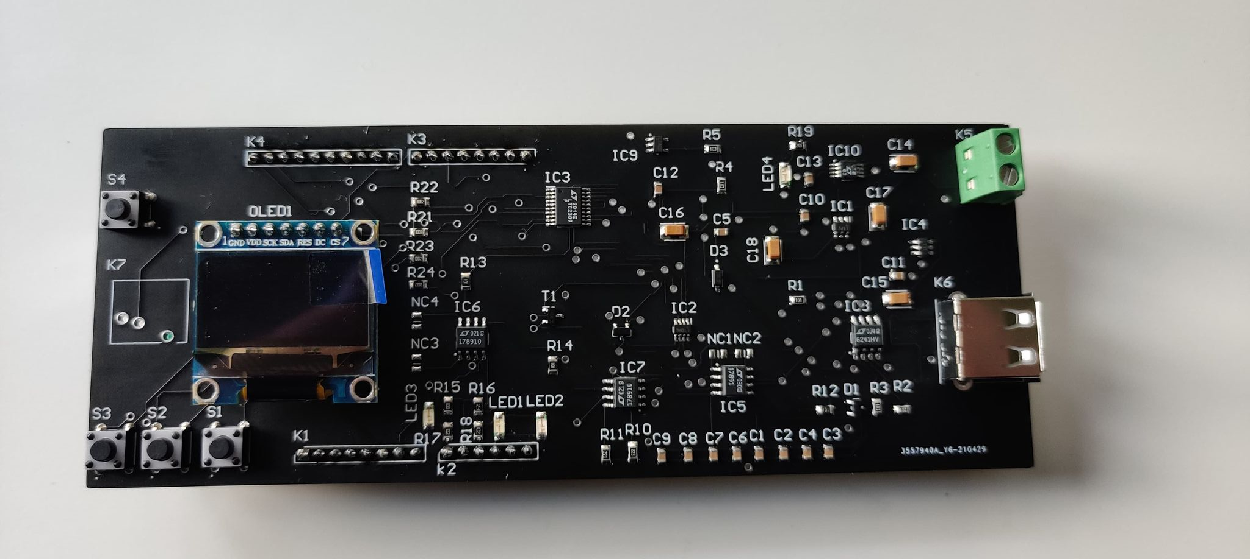
How it works
3 modes
Stand by
Local
Remote

Slide 8
discussion
Difficulties
Electrical diagrams
Tuning the case
Delivery PCB
Mistakes
Altium
Footprint powerjack

Slide 9
The end
“It always seems impossible until it’s done.
Nelson Mandela”

